Slide 1

Data Science Project - Presence of Heart Disease
By: Vinicius and Kishore

Slide 2

Presentation Outline
Objectives
Data Source
Methodology
Evaluation/Results
Summary

Slide 3
Objectives:
Determine the factors that lead to Heart Disease
Predict the likeliness
of Heart Disease
Visualization –
Presence of Heart Disease
Determine the factors that lead to Heart Disease
Predict the likeliness
of Heart Disease
Visualization –
Presence of Heart Disease

Slide 4

Data Source
Source: SAMPLE DATA: Heart Disease Data Set
Statistics:
Observation/Rows- 303 (excluding headers)
Features – 13
Primary Feature – Presence of Heart Disease (0/1)
Value 0: < 50% diameter narrowing in any major vessel
Value 1: > 50% diameter narrowing in any major vessel

Slide 5
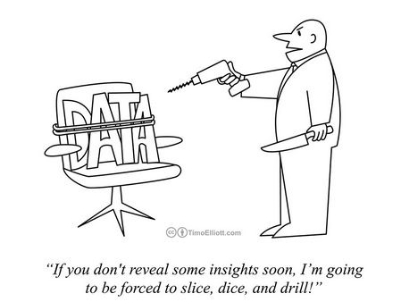
Methodology

Slide 6
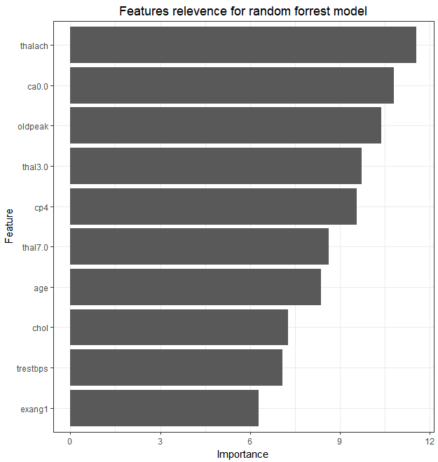
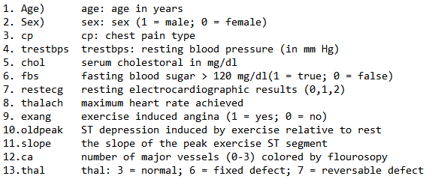

13 features extracted
from raw data
Build predictive
model using
multiple techniques
Optimal model
identified through
testing and evaluation
Identified top variables
that explained
Presence of
Heart Disease
Methodology

Slide 7
Evaluation/Results

Slide 8
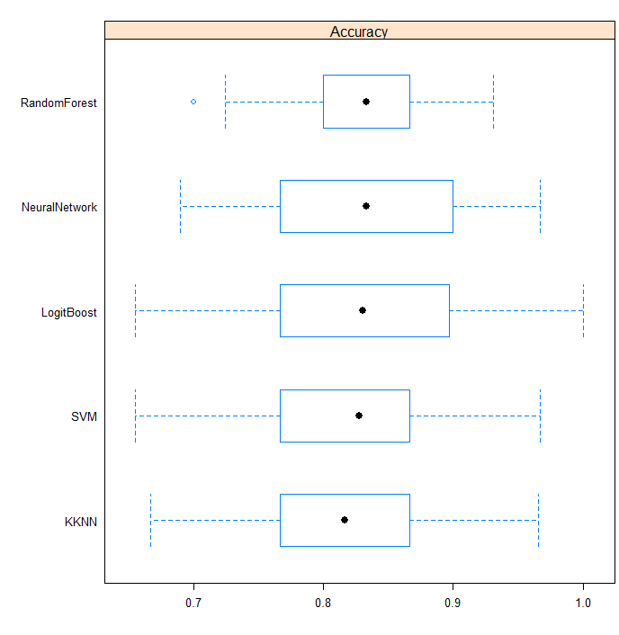
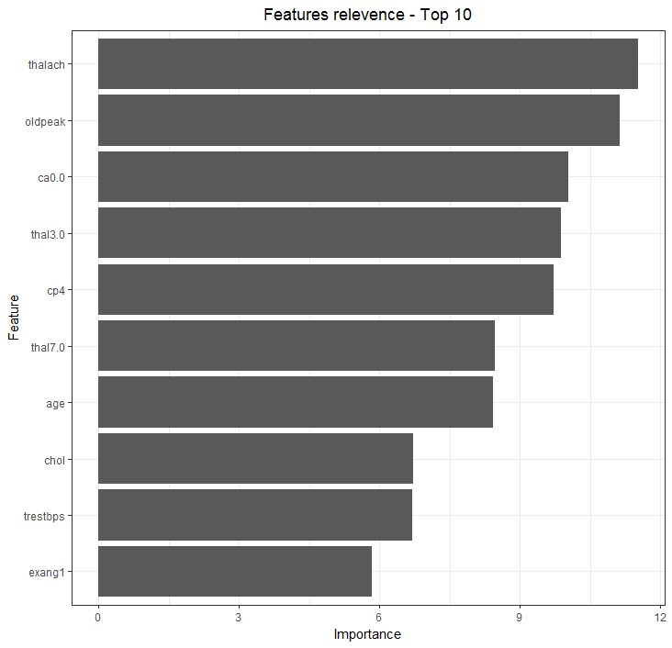
5 methods were used to train the model. Random Forest achieved a median accuracy of 83%.
Random Forest model selected 22 features to predict if there is heart disease or not.

Slide 9
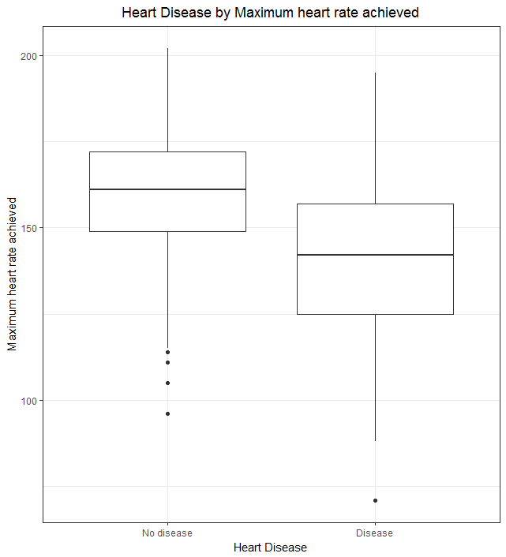
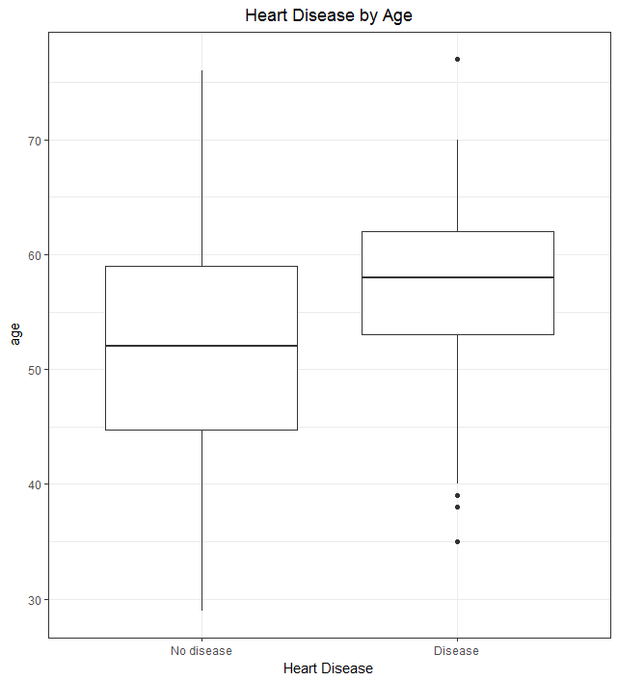
People with heart disease achieved a lower maximum heart rate.
Older people are more likely to have heart disease.

Slide 10
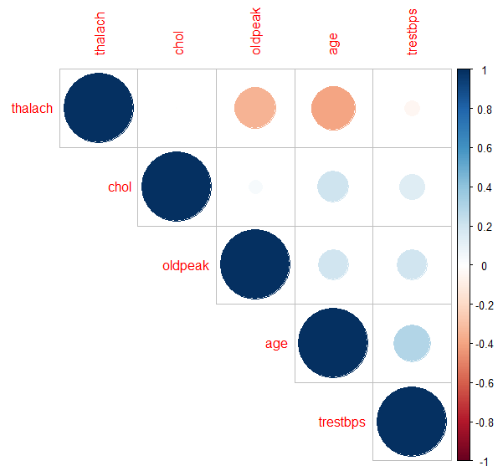
People with heart disease achieved a lower maximum heart rate.
Older people are more likely to have heart disease.
Thalach (maximum heart rate achieved) vs Age
Correlation between features

Slide 11
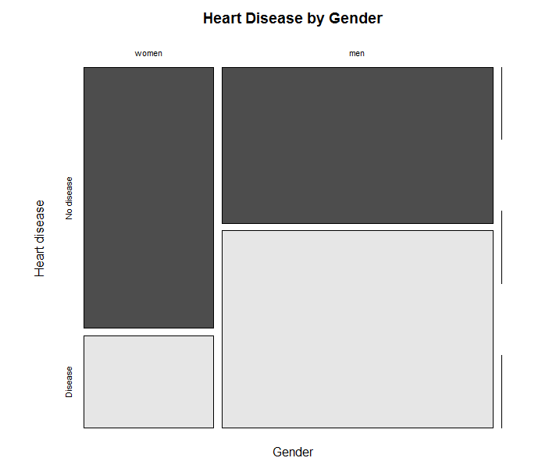
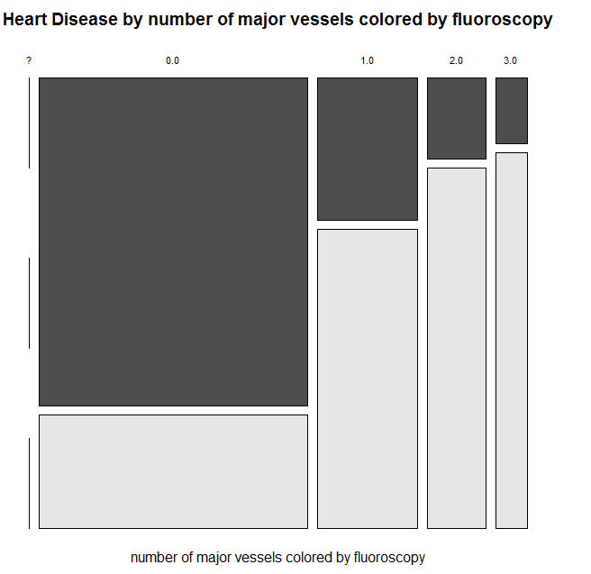
Men are more likely to have heart disease compared to women.
Number of vessels colored by fluoroscopy is strongly related to heart disease diagnosis.

Slide 12

Insights
Demo
The model created using Random Forest method achieved a good accuracy and also selected the features.
Correlogram is a good tool to investigate features correlation.
Correct features classification between numerical and factor helped fine tuning the model.
Model training and variables importance visualization is a good approach to start investigate features influence to predicted variable.
Three observations that shows presence of Heart Disease as predicted by Random Forest:
Age/Thalach (maximum heart rate achieved)
CA (number of major vessels (0-3) colored by fluoroscopy)
Cholesterol
Summary

Slide 13
Q & A

Slide 14
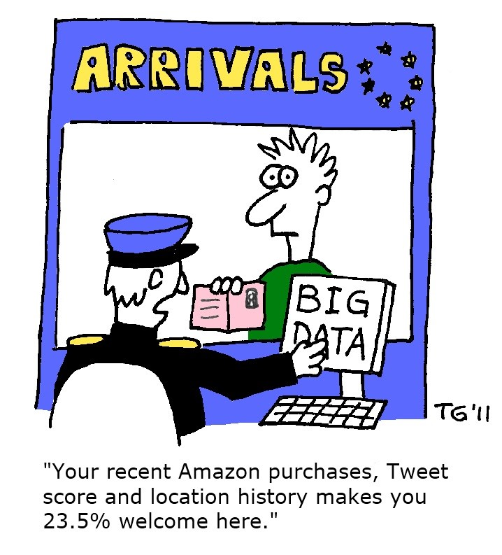
Thank you

